Slide 1
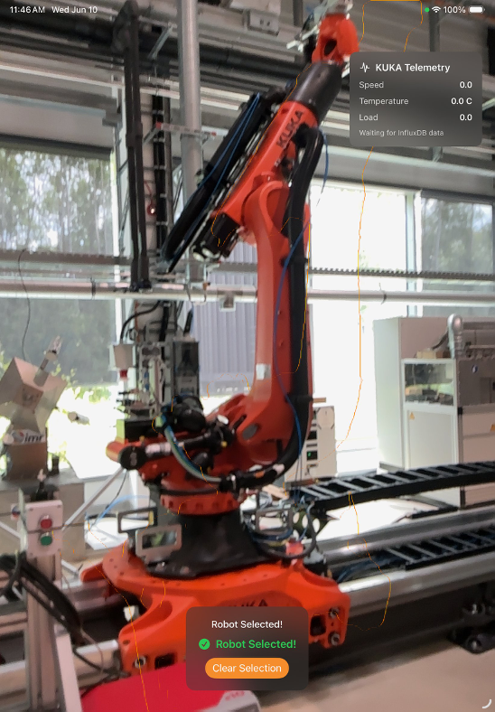
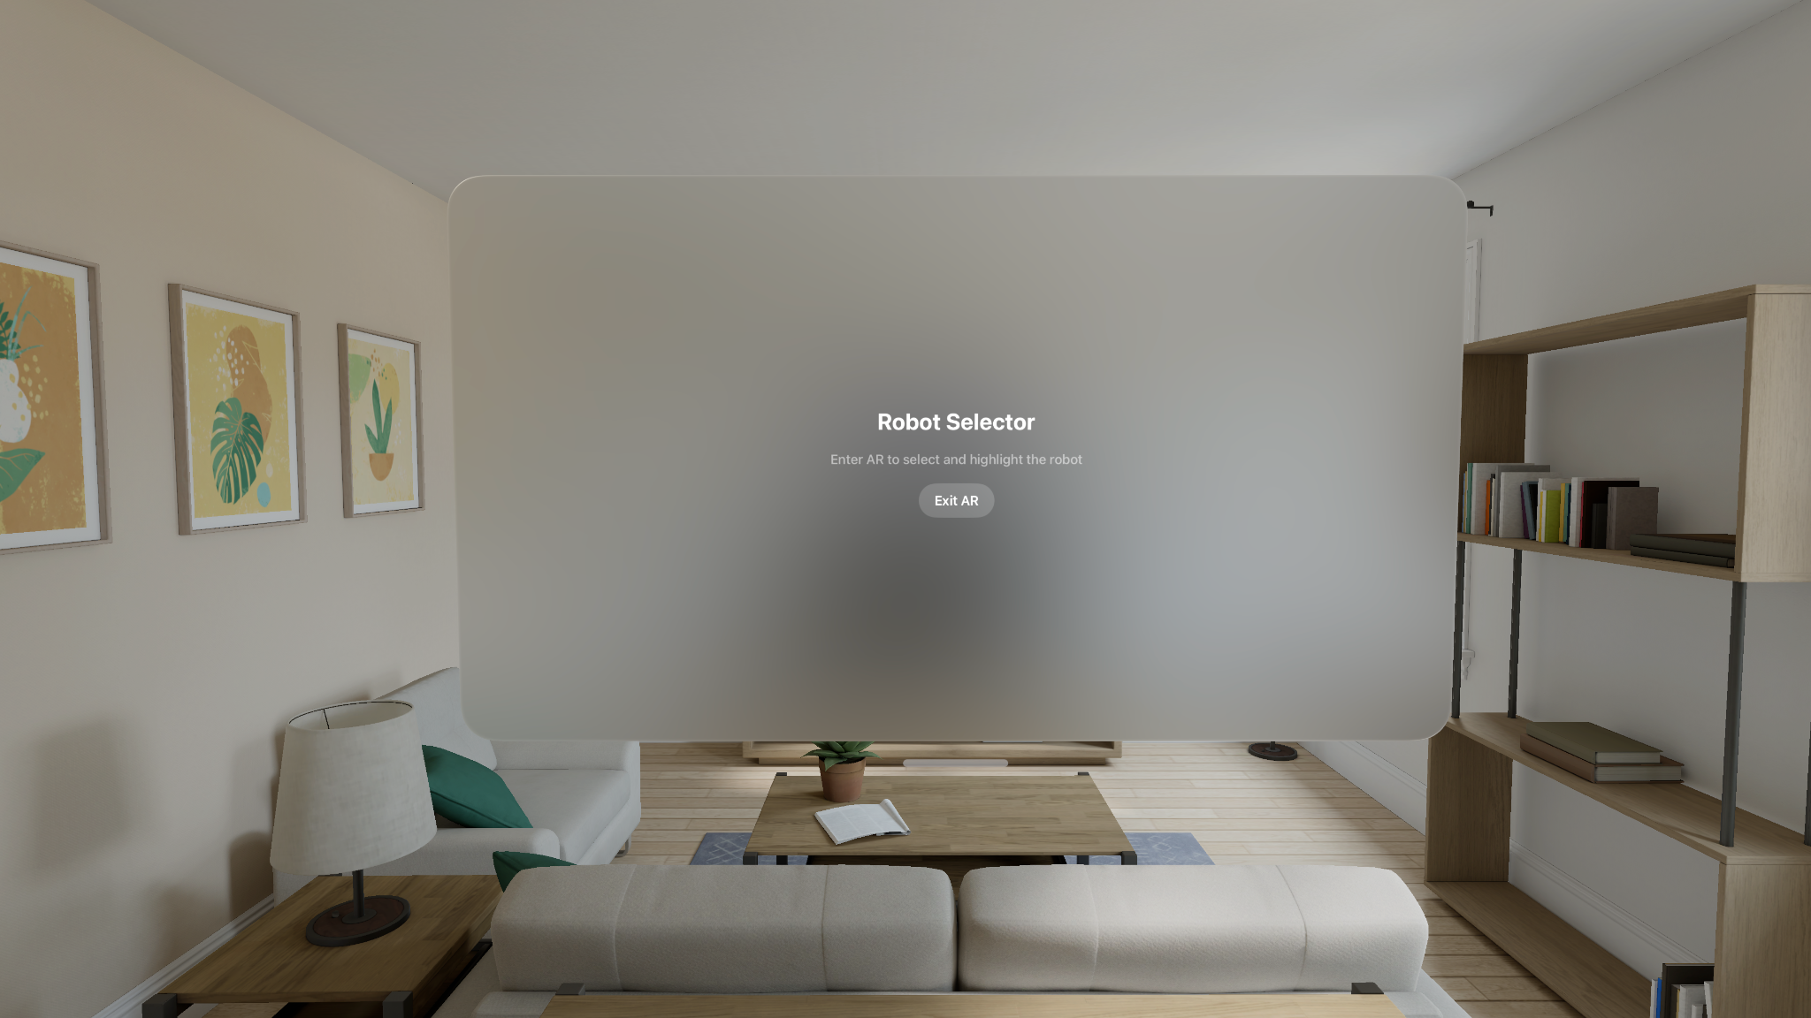
Simplifying Data Acquisition in Production
Student Engineering Research Program (SERP)
Yuvraj — Industrial Engineering
Purdue University
An Apple Vision Pro Application — RobotSelector
Apple Vision Pro (visionOS) & iPad (iPadOS) • Swift, SwiftUI, RealityKit, ARKit, Roboflow, InfluxDB
Identifying KUKA robotic arms on the shop floor via AR and surfacing their live machine telemetry in place — removing the need for a separate data-acquisition dashboard.
1
INTRODUCTION
Industrial mixed reality lets a technician look at real machinery and see live, contextual data floating in space — no separate dashboard or manual lookup required.
This SERP project builds RobotSelector: a mixed-reality app that recognizes a physical KUKA robotic arm through the camera, lets the user select it with a gaze/pinch or a tap, and displays its live telemetry (temperature, speed, load) directly above it in AR.
The app targets two platforms from largely shared code: Apple Vision Pro (visionOS, hands-free gaze + pinch) and iPad (iPadOS, tap-to-select via ARKit raycasting), so it can be tested on hardware immediately available in the lab.
The project grew out of an earlier iOS object-detection prototype (AVFoundation + Core ML), then moved to ARKit scene reconstruction on Vision Pro, then added a custom-trained computer-vision model and live sensor telemetry.
Key challenge: consumer AR platforms are built around strict camera-privacy models, and general-purpose vision models don't reliably distinguish one KUKA arm from the surrounding machinery — both had to be solved from scratch.
2
PROJECT
Goal
visionOS vs. iPadOS
Detect a specific KUKA robot model in the camera view and let the user select it with a natural gesture.
Overlay a floating panel above the selected robot with live telemetry pulled from InfluxDB.
Share the RealityKit/ARKit selection and overlay logic across visionOS and iPadOS targets.
Concept | Vision Pro | iPad
Entry point | ImmersiveSpace | WindowGroup only
AR view | RealityView | ARView (UIKit bridge)
Gesture | Gaze + pinch | Screen tap
Mesh access | SceneReconstructionProvider | ARWorldTrackingConfiguration
Hit detection | Mesh collision | arView.raycast()
Highlight | Material on mesh entity | Sphere at hit point
Technical Stack
Swift, SwiftUI, RealityKit, ARKit (SceneReconstructionProvider, WorldTrackingProvider)
Roboflow-hosted instance-segmentation model, custom-trained on KUKA arm images
InfluxDB (line protocol writes, Flux queries) for live sensor telemetry
Core ML / Vision framework (earlier iOS prototype: YOLOv3 object detection)
RealityKit entities, components, and materials are written once and reused unchanged on both platforms — only AR-session setup differs.
Code Sample — iPad Tap-to-Select (ARViewModel.swift)
Live ML Detection Pipeline
Roboflow instance segmentation (not just bounding boxes) runs on-camera-frame every 1.5s via the Roboflow Serverless API, filtered to the KUKA class at ≥ 50% confidence — confirmed reliable between 20–88% threshold. The API key is kept out of source control via an .xcconfig file read at runtime through Bundle.main.infoDictionary.
func handleTap(at point: CGPoint) {
let results = arView.raycast(
from: point,
allowing: .estimatedPlane,
alignment: .any)
guard let hit = results.first else {
statusMessage = "Missed — try again"
return
}
placeHighlight(at: hit.worldTransform)
objectIsSelected = true
}
Camera / AR Frame
Roboflow Inference
(every 1.5s)
Confidence Filter
(≥ 0.5, KUKA class)
AR Highlight +
Segmentation Overlay
Figure: live KUKA telemetry overlay, iPad build
InfluxDB Telemetry
Polling (2s)
3
DEVELOPMENT TIMELINE
01
02
03
04
iOS Camera Prototype
Core ML Object Detection
visionOS Mesh Selection
iPad Port
Built a live camera app with AVFoundation (AVCaptureSession, UIViewRepresentable bridging) and Vision-framework object detection to learn the core capture pipeline before touching AR.
Upgraded from Vision rectangle-detection (fails on curved objects) to a YOLOv3 Core ML model via VNCoreMLRequest, plus UUID-based tracking to stop bounding-box flicker.
Built the first RobotSelector visionOS app: ARKit SceneReconstructionProvider meshes the room, SpatialTapGesture + collision highlights the tapped chunk orange.
Ported selection logic to iPadOS using ARWorldTrackingConfiguration and arView.raycast(), with automatic fallback from LiDAR mesh to plane detection on non-LiDAR devices.
05
06–07
08
What's next →
InfluxDB Telemetry
Custom ML via Roboflow
Camera Restriction Discovered
Live camera access, multi-robot routing, and full hardware implementation on physical Apple Vision Pro (No iPad needed)
Added an InfluxDB client (line-protocol writes, Flux queries) and a floating RobotDataOverlay panel showing live temperature, speed, and load above the selected robot.
Replaced generic Vision segmentation with a custom-trained Roboflow instance-segmentation model for KUKA-specific detection, secured with an .xcconfig API key pattern.
Found that visionOS 1.0–1.2 exposes no public API for raw camera frames — a deliberate privacy limit, not a bug — and built static-image workarounds to keep developing.
4
CHALLENGES AND LEARNINGS
1
2
3
4
visionOS Camera Restriction
Generic Segmentation Wasn't Enough
One Codebase, Two Interaction Models
Flickering & Camera Freezes
As of visionOS 1.0–1.2, Apple provides no public API to stream raw camera frames (CVPixelBuffer) to third-party apps — an intentional privacy decision, not a bug. This blocked the planned live Roboflow inference loop on Vision Pro hardware.
Apple's built-in VNGenerateForegroundInstanceMaskRequest segments any foreground object — it cannot tell a KUKA arm apart from other lab equipment, and offered no class labels or confidence scores.
visionOS uses gaze + pinch with mesh-entity collision; iPad has no gaze input and must raycast from a 2D tap into the 3D world. Early attempts duplicated app logic per platform.
Early iOS prototype bounding boxes flickered because every detection shared the ID “Object,” and later builds froze because Vision/Core ML work competed with the camera session on the same thread.
Fix: Workaround: mesh-based tap selection (geometry, not pixels) as a fallback, plus static test images cycled through the asset catalog to develop and demo the ML pipeline while awaiting a future frame-access API.
Fix: Solution: trained a custom Roboflow instance-segmentation model on labeled KUKA images, called via the Roboflow Serverless API every 1.5s, filtering results to the KUKA robot class at ≥ 50% confidence.
Fix: Solution: kept ARKit session setup and gesture handling platform-specific, but shared all RealityKit entity, material, and InfluxDB telemetry code unchanged across both targets.
Fix: Solution: gave each detection a stable UUID (Identifiable), throttled inference to every 3–6 frames, capped zoom, and dropped resolution to 720p to keep the capture pipeline responsive.
This project built working knowledge of ARKit/RealityKit AR pipelines, cross-platform Swift architecture, custom computer-vision model training and deployment via Roboflow, and time-series telemetry integration with InfluxDB — while learning to recognize platform limitations early and design around them rather than against them. The visionOS Simulator (left) cannot stream a live camera or run scene reconstruction, but it was used throughout development to verify SwiftUI layout, the Enter/Exit AR flow, and InfluxDB polling logic without needing hardware in hand. It also confirmed that console warnings such as “Authorization requests cannot be performed on Simulator” are expected simulator behavior, not bugs.
Figure: visionOS Simulator — Enter/Exit AR flow verified before physical Vision Pro access
5
NEXT STEPS
Wire detected robot identity (kuka_1 / kuka_2) into the InfluxDB query filter for correct multi-robot telemetry routing.
Test the full mesh-selection, segmentation-overlay, and telemetry pipeline on physical Apple Vision Pro hardware once available.
Draw the AR overlay directly from Roboflow's segmentation polygon coordinates instead of a placeholder highlight.
Cache the last good detection so the AR overlay persists smoothly between 1.5-second inference cycles.
Continue labeling KUKA images in Roboflow to improve detection accuracy, recall, and performance across distances and lighting.
Monitor upcoming visionOS releases and WWDC sessions for a supported live camera-frame API to replace the static-image workaround.
Extract shared RealityKit material/component logic into a common Swift package used by both the visionOS and iPadOS targets.
Add floating text annotation, proximity-based auto-highlighting, and spatial audio feedback on robot selection.
Simplifying Data Acquisition in Production — Student Engineering Research Program (SERP), Purdue University
Frameworks: SwiftUI · RealityKit · ARKit · Roboflow · InfluxDB

